Slide 1
Module 1, Section 1: Cloud Concepts Overview
© 2018, Amazon Web Services, Inc. or its Affiliates. All rights reserved.
Notes:
Welcome to Module 1, Section 1 – Cloud Concepts Overview.

Slide 2
What’s In This Module
Part 1: What is Cloud Computing?
Part 2: Six Advantages of Cloud Computing
Part 3: What is Amazon Web Services (AWS)?
Part 4: The AWS Cloud Adoption Framework (CAF)
Notes:
In this module, we are going to discuss the basics of cloud computing. In part one, you’ll learn what cloud computing is. In part two, you’ll discover the six advantages of cloud computing. In part three, we’ll reveal what Amazon Web Services is, and in part four, you’ll discover the AWS Cloud Adoption Framework.
This course assumes that you have a non-IT background, as it will not teach you how to build applications in the cloud. This course will give you a general conceptual understanding about the cloud and AWS.

Slide 3
Module Objectives
Discuss key concepts related to cloud computing and the advantages of cloud computing:
Define different types of cloud computing.
Describe six advantages of cloud computing.
Describe cloud deployment models.
Review the AWS Cloud Adoption Framework (CAF).
Notes:
The goal of this module is to discuss key concepts related to cloud computing and the advantages of cloud computing with Amazon Web Services.
We will:
• Define different types of cloud computing to understand internet-based computing and three broad categories of cloud computing.
• Describe the six advantages of cloud computing that are helping organizations make the decision to get out of the low-value parts of IT and focus on things that drive business success.
• Describe three cloud deployment models to understand alternative models of cloud usage.
• Review the AWS Cloud Adoption Framework which helps organizations understand how cloud adoption transforms the way they work.
After this overview, you will have the opportunity to complete a Knowledge Assessment.

Slide 4
Part 1: What is Cloud Computing?
Notes:
In part one, we’ll answer the question, “What is cloud computing?”

Slide 5
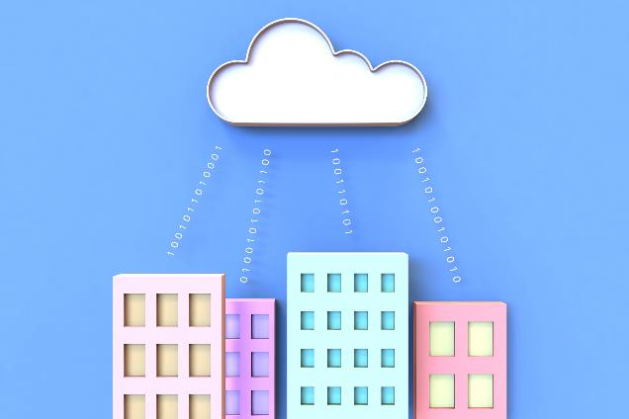
What is Cloud Computing?
Notes:
What does cloud computing mean to you?
Take a moment to provide a quick sentence on what you understand cloud computing to be.
Note: There’s no wrong answer.

Slide 6
What is Cloud Computing?
Cloud computing is the on-demand delivery of compute power, database storage, applications, and other IT resources through a cloud services platform via the internet with pay-as-you-go pricing.
Notes:
Cloud computing is the on-demand delivery of compute power, database storage, applications, and other IT resources through a cloud services platform via the internet, with pay-as-you-go pricing.
The most basic way to define what the “cloud” is that it is a computer located somewhere else that is accessed via the Internet and utilized in some way. Web services is also another name for what people call the cloud.
The cloud is comprised of server computers located in large data centers in different locations around the world. When you use a cloud service like Amazon Web Services (AWS), you are utilizing the computers owned by AWS. AWS is a cloud services provider.
The computers contain various technology features and services, like building blocks, that can be used to assemble solutions that help a user meet their business goals and technology requirements. With cloud computing, organizations can consume on-demand computing and storage resources rather than building, operating, and improving infrastructure on their own.
Visit the link to learn more
https://aws.amazon.com/what-is-cloud-computing/.

Slide 7
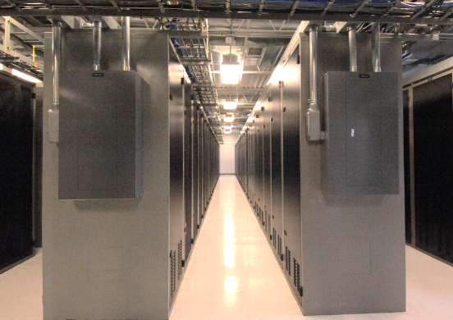

Before Cloud Computing
Cloud computing enables you to stop thinking of your infrastructure as hardware, and instead think of it (and use it) as software.
Notes:
Cloud computing enables you to stop thinking of your infrastructure as hardware, and instead think of it (and use it) as software. Before cloud computing, you would have to provision capacity based on guessing theoretical maximum peaks. If you didn’t meet your projected maximum peaks, or you exceeded them, you would be paying for expensive resources that would stay idle or have insufficient capacity to meet your needs.

Slide 8
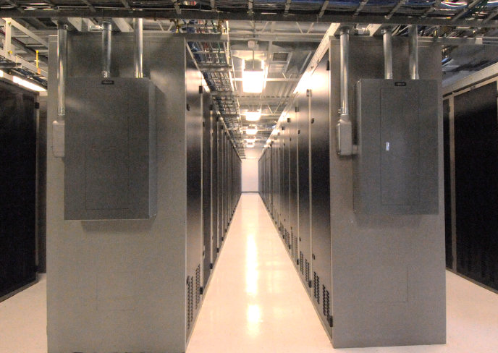
Before Cloud Computing
Hardware solutions are physical. This means they require:
Space
Staff
Physical security
Planning
Capital expenditure
Guess at theoretical maximum peaks
Is there enough resource capacity?
Do we have sufficient storage?
What if your needs change?
You have to go through the time, effort, and cost required to change all these.
Notes:
Managing hardware takes away time and resources you could be using to improve your architecture and your application. Hardware solutions are physical. This means they require space, staff, physical security, planning and capital expenditure.
You have to guess at theoretical maximum peaks, asking if there is enough resource capacity or if you have sufficient storage. What if your needs change? You have to go through the time, effort, and cost required to change all of these.
For example, if you want to provision a new web site, you would have to go out and buy the hardware, rack and stack it, put it in a data center, and then manage it or have someone else manage it. This approach is very expensive.
Cloud computing addresses some of the issues in the traditional computing model. One of the most prohibitive aspects of traditional computing is the significant up-front investment of acquiring, provisioning, and maintaining on-premises infrastructure. Cloud computing can get businesses up and running with a new solution in place quickly and with very low up-front costs. Then, you can elastically scale up and down in an automated fashion so that you pay only for what you use.
Cloud computing also allows you to select the services that best match your needs, giving you flexibility with a wide range of choices and the ability to change your configuration at will. All of these services are provided on a secured infrastructure.

Slide 9

Utilizing Cloud Computing
Software is flexible.
If your needs change, your software can change much more quickly, easily, and cost-effectively than your hardware.
Notes:
Accessing and using your infrastructure as software offers a number of benefits-flexibility in particular. If your needs change, your software can change much more quickly, easily, and cost-effectively than your hardware.
With a cloud services provider like AWS, you don't have to anticipate your hardware needs ahead of time and then order, install, and set it up at your data center. You also don’t need to undergo a long procurement cycle. With a few clicks, you can provision exactly what you need-and it will be available to you in a few minutes.
That means you can provision and terminate resources as necessary on AWS, instead of paying for hardware when you’re not using it. You can treat resources as temporary and disposable resources, free from the inflexibility and constraints of a fixed and finite IT infrastructure.
By harnessing the power of AWS, you can be more agile and efficient with change management, testing, reliability, and capacity planning.

Slide 10

Three Models of Cloud Computing
IaaS
Infrastructure as a Service
PaaS
Platform as a Service
SaaS
Software as a Service
Notes:
Cloud services can fall into one of three primary categories, based mainly around how much control and responsibility you have over how the service is configured.
With IaaS (or Infrastructure as a Service), you manage the server, which can be physical or virtual, as well as the operating system (Windows or Linux). In general, the data center provider has no access to your server.
Basic building blocks for cloud IT include:
Networking features
Compute, and
Data storage space
With PaaS (or Platform as a Service), someone else manages the underlying hardware and operating systems. This enables you to run applications without managing underlying infrastructure (for example -- patching, updates, maintenance, hardware and operating systems). PaaS also provides a framework for developers that they can build upon to create customized applications.
With SaaS (or Software as a Service), you manage your files, while the service provider takes care of all of the data centers, servers, networks, storage, maintenance, patching, etc. All you worry about is the software and how you want to use it. You are provided with a complete product that is run and managed by the service provider. Facebook and Dropbox are examples of SaaS. You manage your Facebook contacts and Dropbox files, and the service providers manage the systems.

Slide 11
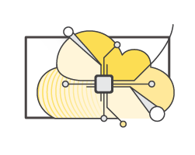
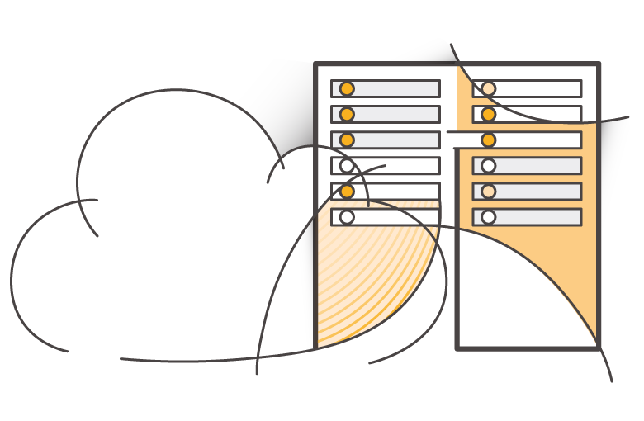
Three Cloud Deployment Models
All-In Cloud
Hybrid
Private Cloud
(On-premises)
Notes:
Now, let’s reveal the three cloud deployment models.
"All-In" Cloud is a cloud-based application that is fully deployed in the cloud, and all parts of the application run in the cloud. Applications in the cloud have either been created in the cloud or have been migrated from an existing infrastructure. Cloud-based applications can be built on low-level infrastructure pieces (for example, networking, compute or storage) or can use higher-level services that provide abstraction from the management, architecting, and scaling requirements of core infrastructure.
A hybrid deployment is a way to connect infrastructure and applications between cloud-based resources and existing resources that are not located in the cloud. The most common method of hybrid deployment is between the cloud and existing on-premises infrastructure (sometimes called on-prem). On-premises infrastructure is located within the physical confines of an enterprise, often in the company's data center. A hybrid deployment model is used to extend an organization's infrastructure into the cloud while connecting cloud resources to an internal system. For more information on how AWS can help you with your hybrid deployment, visit the link https://aws.amazon.com/enterprise/hybrid/.
When you run a cloud infrastructure from your own data center, that’s called on-premises or private cloud. While this kind of deployment lacks many of the benefits of cloud computing, it does provide dedicated resources and is a popular choice for organizations who need to meet certain compliance standards. In most cases, this deployment model is the same as legacy IT infrastructure while using application management and virtualization to increase resource utilization.

Slide 12
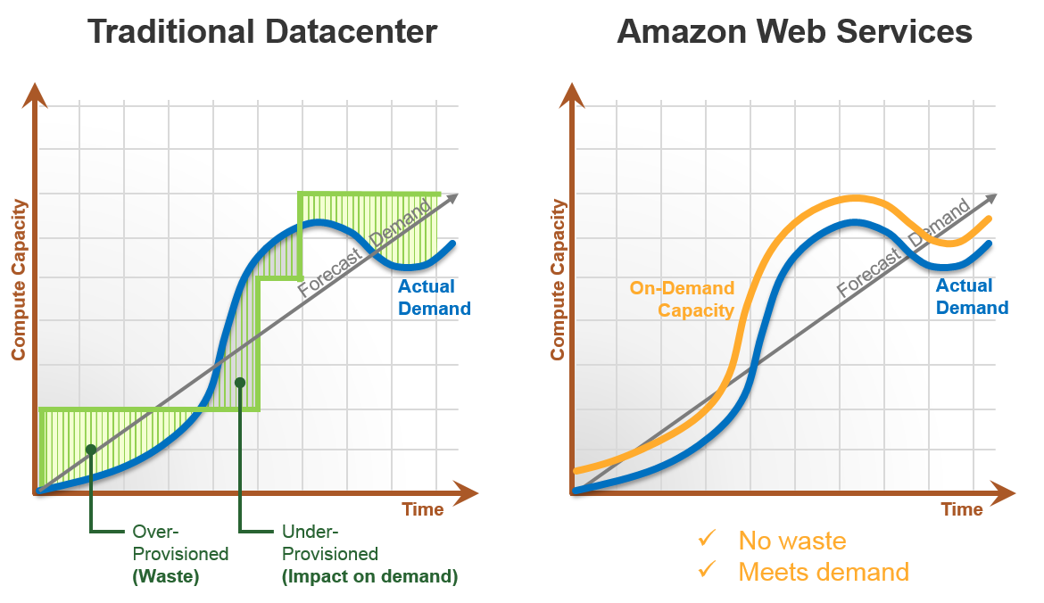
All-In Cloud versus On-Premises
All-In Cloud
On-Premises
No upfront investment
Large initial purchases
Low on-going costs
Labor, patches and upgrade cycles
Focus on innovation
Systems administration
Flexible capacity
Fixed capacity
Speed and agility
Procurement and setup
Global reach on demand
Limited geographic regions
Notes:
Let’s take a closer look at capacity in the All-In Cloud and On-Premises solutions.
In the “All In” solution, capacity is in sync with demand. Resources are provisioned and decommissioned in response to demand with only a couple clicks.
In contrast, in “On-Premises” deployments, because you rely on physical hardware, you have to forecast your capacity needs well in advance of the actual demand. Instead of resources that expand and contract with demand, the on-premises solution results in idle, wasted resources waiting for demand to catch up. If demand suddenly outpaces capacity, the shortfall may result in unhappy customers. Your ability to respond quickly to this situation can be limited by long procurement cycles or by constraints on where you house your IT resources. Furthermore, building an on-premises infrastructure can be slow and expensive.

Slide 13
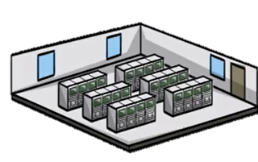
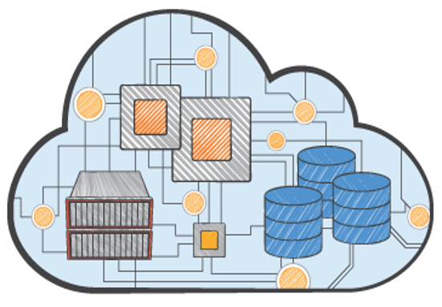
All-In Cloud versus On-Premises
All-In Cloud
No upfront investment
Low ongoing costs
Focus on innovation
Flexible capacity
Speed and agility
Global reach on demand
On-Premises
Large initial purchase
Labor, patches, and upgrade cycles
Systems administration
Fixed capacity
Long procurement cycle and setup
Limited geographic regions
Notes:
To summarize:
With the All-In solution, there is no upfront investment, so you avoid the large capital purchases required for an On-Premises solution. You have immediate access to resources without having to procure, install, and configure cabling, racks, servers, and storage in a physical location with appropriate facilities like cooling and power. Instead, you just click to order and pay for the resources you need, which are available almost immediately.
Cloud computing helps you reduce ongoing IT costs in multiple ways. AWS continually lowers prices due to massive economies of scale and continual improvements. Multiple pricing options also help you optimize costs based on your unique workloads. You pay only for what you use on a variable, monthly basis. On-premises solutions typically require upgrades on 1-year, 3-year, or 5-year cycles.
Cloud gives you managed IT resources on demand, at a fraction of the cost of traditional infrastructure. This cost savings empowers organizations to shift resources toward innovative new projects that grow their business by focusing on “apps not ops.”
Predicting how customers are going to adopt your new application is complex, making it difficult to estimate your infrastructure capacity needs. Flexible capacity means that your resources are dynamic. You can quickly provision resources as demand goes up and turn off what you don’t need as demand declines.
Cloud computing’s speed and agility makes it possible for you to respond to changing market conditions. With AWS, resources can be provisioned as needed. This self-service environment changes how you develop and deploy applications, allowing your team to experiment more quickly and more frequently. The amount of time it takes to get a server procured, delivered, and running limits this in a traditional infrastructure.
With on-premises, it is hard to deliver great performance to a distributed user base. The initial purchase is large, it’s labor intensive with patches, upgrade cycles and systems administration with fixed capacity. There are long procurement cycles and setup, so companies focus on one geographic region at a time to save costs and time. Without geographical limitations, you can deploy your application in any of the AWS regions around the world with lower latency and at minimal cost.

Slide 14
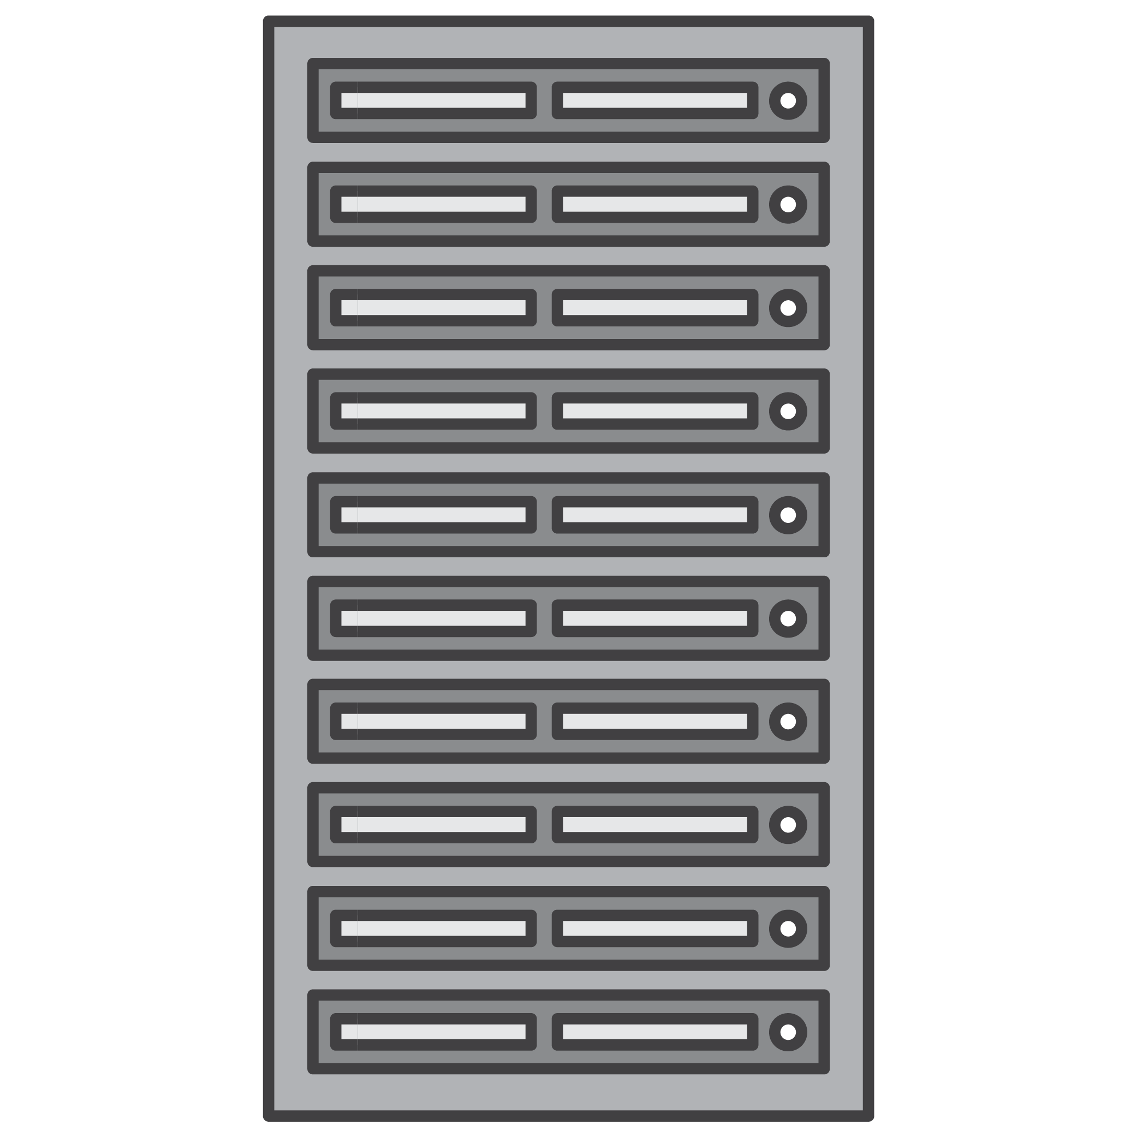

What can you do in the cloud?
You can use a cloud computing platform for:
Application Hosting
Backup and Storage
Content Delivery
Websites
Enterprise IT
Databases
Notes:
You can use a cloud computing platform for the following:
• Application Hosting for an on-demand infrastructure to host internal or SaaS applications.
• Backup and Storage to store data and build dependable backup solutions.
• Content Delivery to distribute content worldwide, with high data transfer speeds.
• Host static and dynamic websites.
• Enterprise IT to host internal- or external-facing IT applications in AWS's secure environment.
• Use a variety of scalable database solutions, from hosted enterprise database software to non-relational database solutions.

Slide 15






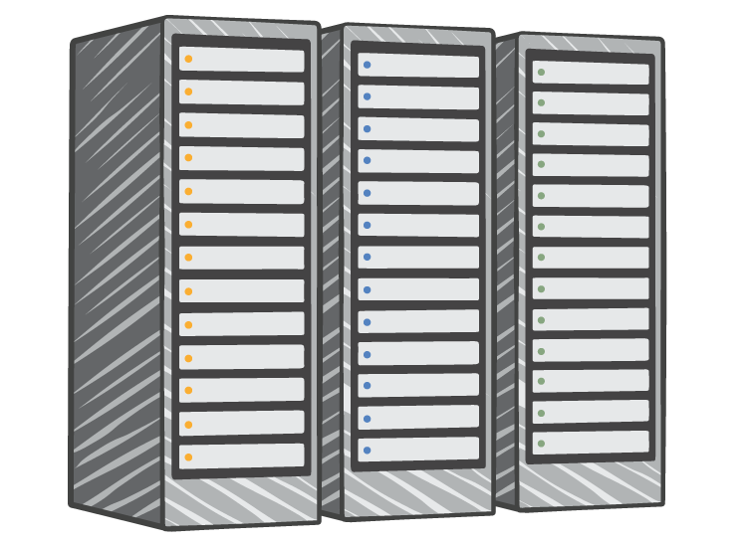




On-Premises and AWS Comparison
On-Premises Infrastructure
Amazon Web Services
Security
Firewalls
ACLs
Administrators
Security Groups
Network Access Control Lists
Identity Access Management
Networking
Network
Router
Network Pipeline
Switch
Elastic Load Balancing
Amazon VPC
On-Premises Servers
Servers
VPC
Amazon Machine Image
Amazon EC2 Instances
DAS
SAN
NAS
Storage and Database
RDBMS
Elastic Block Store
Elastic File System
Amazon S3
Amazon RDS
Notes:
Many AWS services have analogs in the traditional IT space and terminology. This side-by-side comparison shows how Amazon Web Services (AWS) products and services relate to a traditional infrastructure. Pretty much everything you would want to do with a traditional data center is available with AWS.

Slide 16
Important Cloud Terminology
High Availability (Highly Available):
Accessible when you need it
Fault Tolerance (Fault Tolerant):
Ability to withstand a certain amount of failure and still remain functional
Scalability (Scalable):
Ability to easily grow in size, capacity, and/or scope when required
Growth is (usually) based on demand
Elasticity (Elastic):
Ability to grow (scale) when required and to reduce in size when resources are no longer needed
Notes:
Now let’s review some important cloud terminology. High availability, fault tolerance, scalability, and elasticity are four terms often used when discussing the cloud. These concepts are the fundamental building blocks of AWS and will be referred to throughout the course.
High availability refers to a resource that is accessible when you attempt to access it. For example, if every time you go to the ATM to make a withdrawal it works as expected the ATM is highly available; however, if you go to use it and there is a sign on the front that says “Out of Order”, it is not highly available.
Fault tolerance is the ability to withstand a certain amount of failure and still remain functional. It also refers to the ability of a system to be self-healing and return to full capacity despite a failure. It is the ability of a system to fail in some way but still remain functional.
Scalability is the ability to easily grow in size, capacity, and/or scope when required particularly in response to demand. If something cannot quickly grow in an easy manner it is not scalable.
Elasticity is the ability to not only grow (or scale) when required, but also to reduce or contract in size as needed. A system that is elastic can scale to grow as needed usually based on demand and contract as demand decreases.

Slide 17
Summary
Cloud computing is the on-demand delivery of IT resources online with pay-as-you-go pricing.
Three models of cloud computing are:
Infrastructure as a Service (IaaS)
Platform as a Service (PaaS)
Software as a Service (SaaS)
All-in cloud, hybrid, and private cloud are three cloud deployment models.
Cloud services are available to replace traditional on-premises computing activities.
Notes:
In summary, cloud computing is the on-demand delivery of IT resources online with pay-as-you-go pricing.
The three models of cloud computing are:
Infrastructure as a Service (IaaS)
Platform as a Service (PaaS), and
Software as a Service (SaaS)
All-in cloud, hybrid, and private cloud, are three cloud deployment models.
Cloud services are available to replace traditional on-premises computing activities.

Slide 18
Part 2: Six Benefits of Cloud Computing
Notes:
Why are so many companies interested in moving to the cloud? Let’s take a look at the six benefits companies can realize by moving to the cloud.

Slide 19
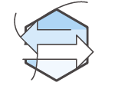
Advantage #1: Capex to Variable Expense
Trade capital expense for variable expense.
Notes:
Advantage 1: Trade Capital Expense for Variable Expense
The first advantage is to trade capital expense for variable expense.
Instead of having to invest heavily in data centers and servers before you know how you’re going to use them, you can pay only when you use computing resources, and pay for how much you use.
Select the link to learn more https://d1.awsstatic.com/whitepapers/aws-overview.pdf.

Slide 20
Capital Expense vs. Variable Expense
Capital expense (capex): Funds used by a company to acquire, upgrade, and maintain physical assets such as property, industrial buildings, or equipment.
Variable expense: A variable expense is an expense that is easily altered or avoided by the person bearing the cost.
Notes:
Capital expenses, or capex, are funds used by a company to acquire, upgrade, and maintain physical assets such as property, industrial buildings, or equipment.
Remember the data center example where we racked and stacked the hardware and then had to manage it all? You have to pay for everything in the data center whether you use it or not. Furthermore, when you purchase a hardware solution, you cannot take advantage of the same massive economies of scale that Amazon can.
A variable expense is an expense that is easily altered or avoided by the person bearing the cost. By using the cloud, businesses won’t have to invest money into data centers and servers, and can pay for only what they use in a pay-as-you-go fashion. This lets businesses save money on technology and enables them to adapt to new applications with as much space as needed in minutes, rather than weeks or days. Maintenance is reduced so the business can spend more time focusing on the core goals of the business.
See the links to learn more.
Source:
https://www.investopedia.com/terms/c/capitalexpenditure.asp
Overview of Amazon Web Services: https://aws.amazon.com/whitepapers/overview-of-amazon-web-services.

Slide 21

Advantage #2: Economies of Scale
Benefit from massive economies of scale.
Notes:
Advantage 2: Benefit from massive economies of scale.
Advantage number two is that you can benefit from massive economies of scale.
By using cloud computing, you can achieve a lower variable cost than you can get on your own.
Select the link to learn more
https://d1.awsstatic.com/whitepapers/aws-overview.pdf.

Slide 22

Economies of Scale
Hardware solutions are physical and require:
Space
Staff
Physical security
Significant cost to procure and house these resources.
No purchasing power.
Cloud providers leverage hundreds of thousands of customers to achieve economies of scale.
Notes:
Data centers require hardware solutions, which are physical, and require space, staff, and physical security. Significant cost and time is associated with the procurement of these resources. Additionally, purchasing power is limited to the size of their individual purchases.
In contrast, with usage from hundreds of thousands of customers are aggregated in the cloud, providers such as Amazon Web Services can achieve higher economies of scale, which translates into lower pay as-you-go prices.
Sources:
AWS | What Is Cloud Computing - Benefits of the Cloud. Amazon Web Services, Inc.N.p., n.d.Web. 31 Aug. 2014.

Slide 23
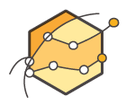
Advantage #3: Capacity Planning
Eliminate guessing on your capacity needs.
Notes:
Advantage 3: Stop guessing about capacity.
Advantage number three is to eliminate guessing on your infrastructure capacity needs.
Source:
https://d1.awsstatic.com/whitepapers/aws-overview.pdf

Slide 24
Guessing about Capacity
What are the potential maximum peaks in usage?
Is there enough resource capacity at peak?
Is the amount of storage sufficient?
Notes:
Before cloud computing, we had to guess about how much resources would be required to accommodate maximum usage peaks. That method also assumed that you could accurately predict the usage peaks, if there’s enough resource capacity and if the amount of storage is sufficient. When you guess, it is very likely that you will probably either buy too much or too little. If you buy too much, you’ve wasted money. If you buy too little, you will have downtime.
With cloud computing, these problems go away. You can access as much or as little as you need, and scale up and down, scale in and out as required with only a few minutes notice.

Slide 25

Advantage #4: Speed and Agility
Increase speed and agility.
Notes:
Advantage 4: Increase speed and agility.
Advantage four is increased speed and agility.
In a cloud computing environment, new IT resources are only a click away, which means you reduce the time it takes to make those resources available to your developers from weeks to just minutes. This results in a dramatic increase in agility for the organization, since the cost and time it takes to experiment and develop is significantly lower.
Source:
https://d1.awsstatic.com/whitepapers/aws-overview.pdf

Slide 26

Increase Speed and Agility
Rapid availability of new resources
Provision resources in minutes, not weeks.
Increase Innovation
Quick, low cost experimentation.
Leverage pre-fabricated functionality without requiring in-house expertise. (i.e., data warehousing, analytics)
Increase experimentation
Explore new avenues of business with minimal risk and expense.
Test with different configurations.
Notes:
Cloud services provide instant global reach and rapid availability of new resources that enables you to quickly change or scale your technology in minutes, not weeks.
Organizational agility is a core differentiator in today’s rapidly changing business environment. For organizations to succeed in a constantly changing world, they need to improve their ability to change and adapt.
You can safely experiment with new ideas and encourage innovation at a very low cost and leverage pre-fabricated functionality without requiring in-house expertise, such as data warehousing and analytics.
You may even find success with ideas that simply weren’t feasible in the past due to hardware or budget constraints. You’re able to explore new avenues of business with minimal risk and expense, and can test with different configurations.

Slide 27

Advantage #5: Spend Strategically
Stop spending money on running and maintaining data centers.
Notes:
Advantage 5: Stop spending money running and maintaining data centers.
Advantage five is to stop spending money running and maintaining data centers.
Focus on projects that differentiate your business, not the infrastructure. Cloud computing lets you focus on your own customers, rather than on the heavy lifting of racking, stacking, and powering servers.

Slide 28
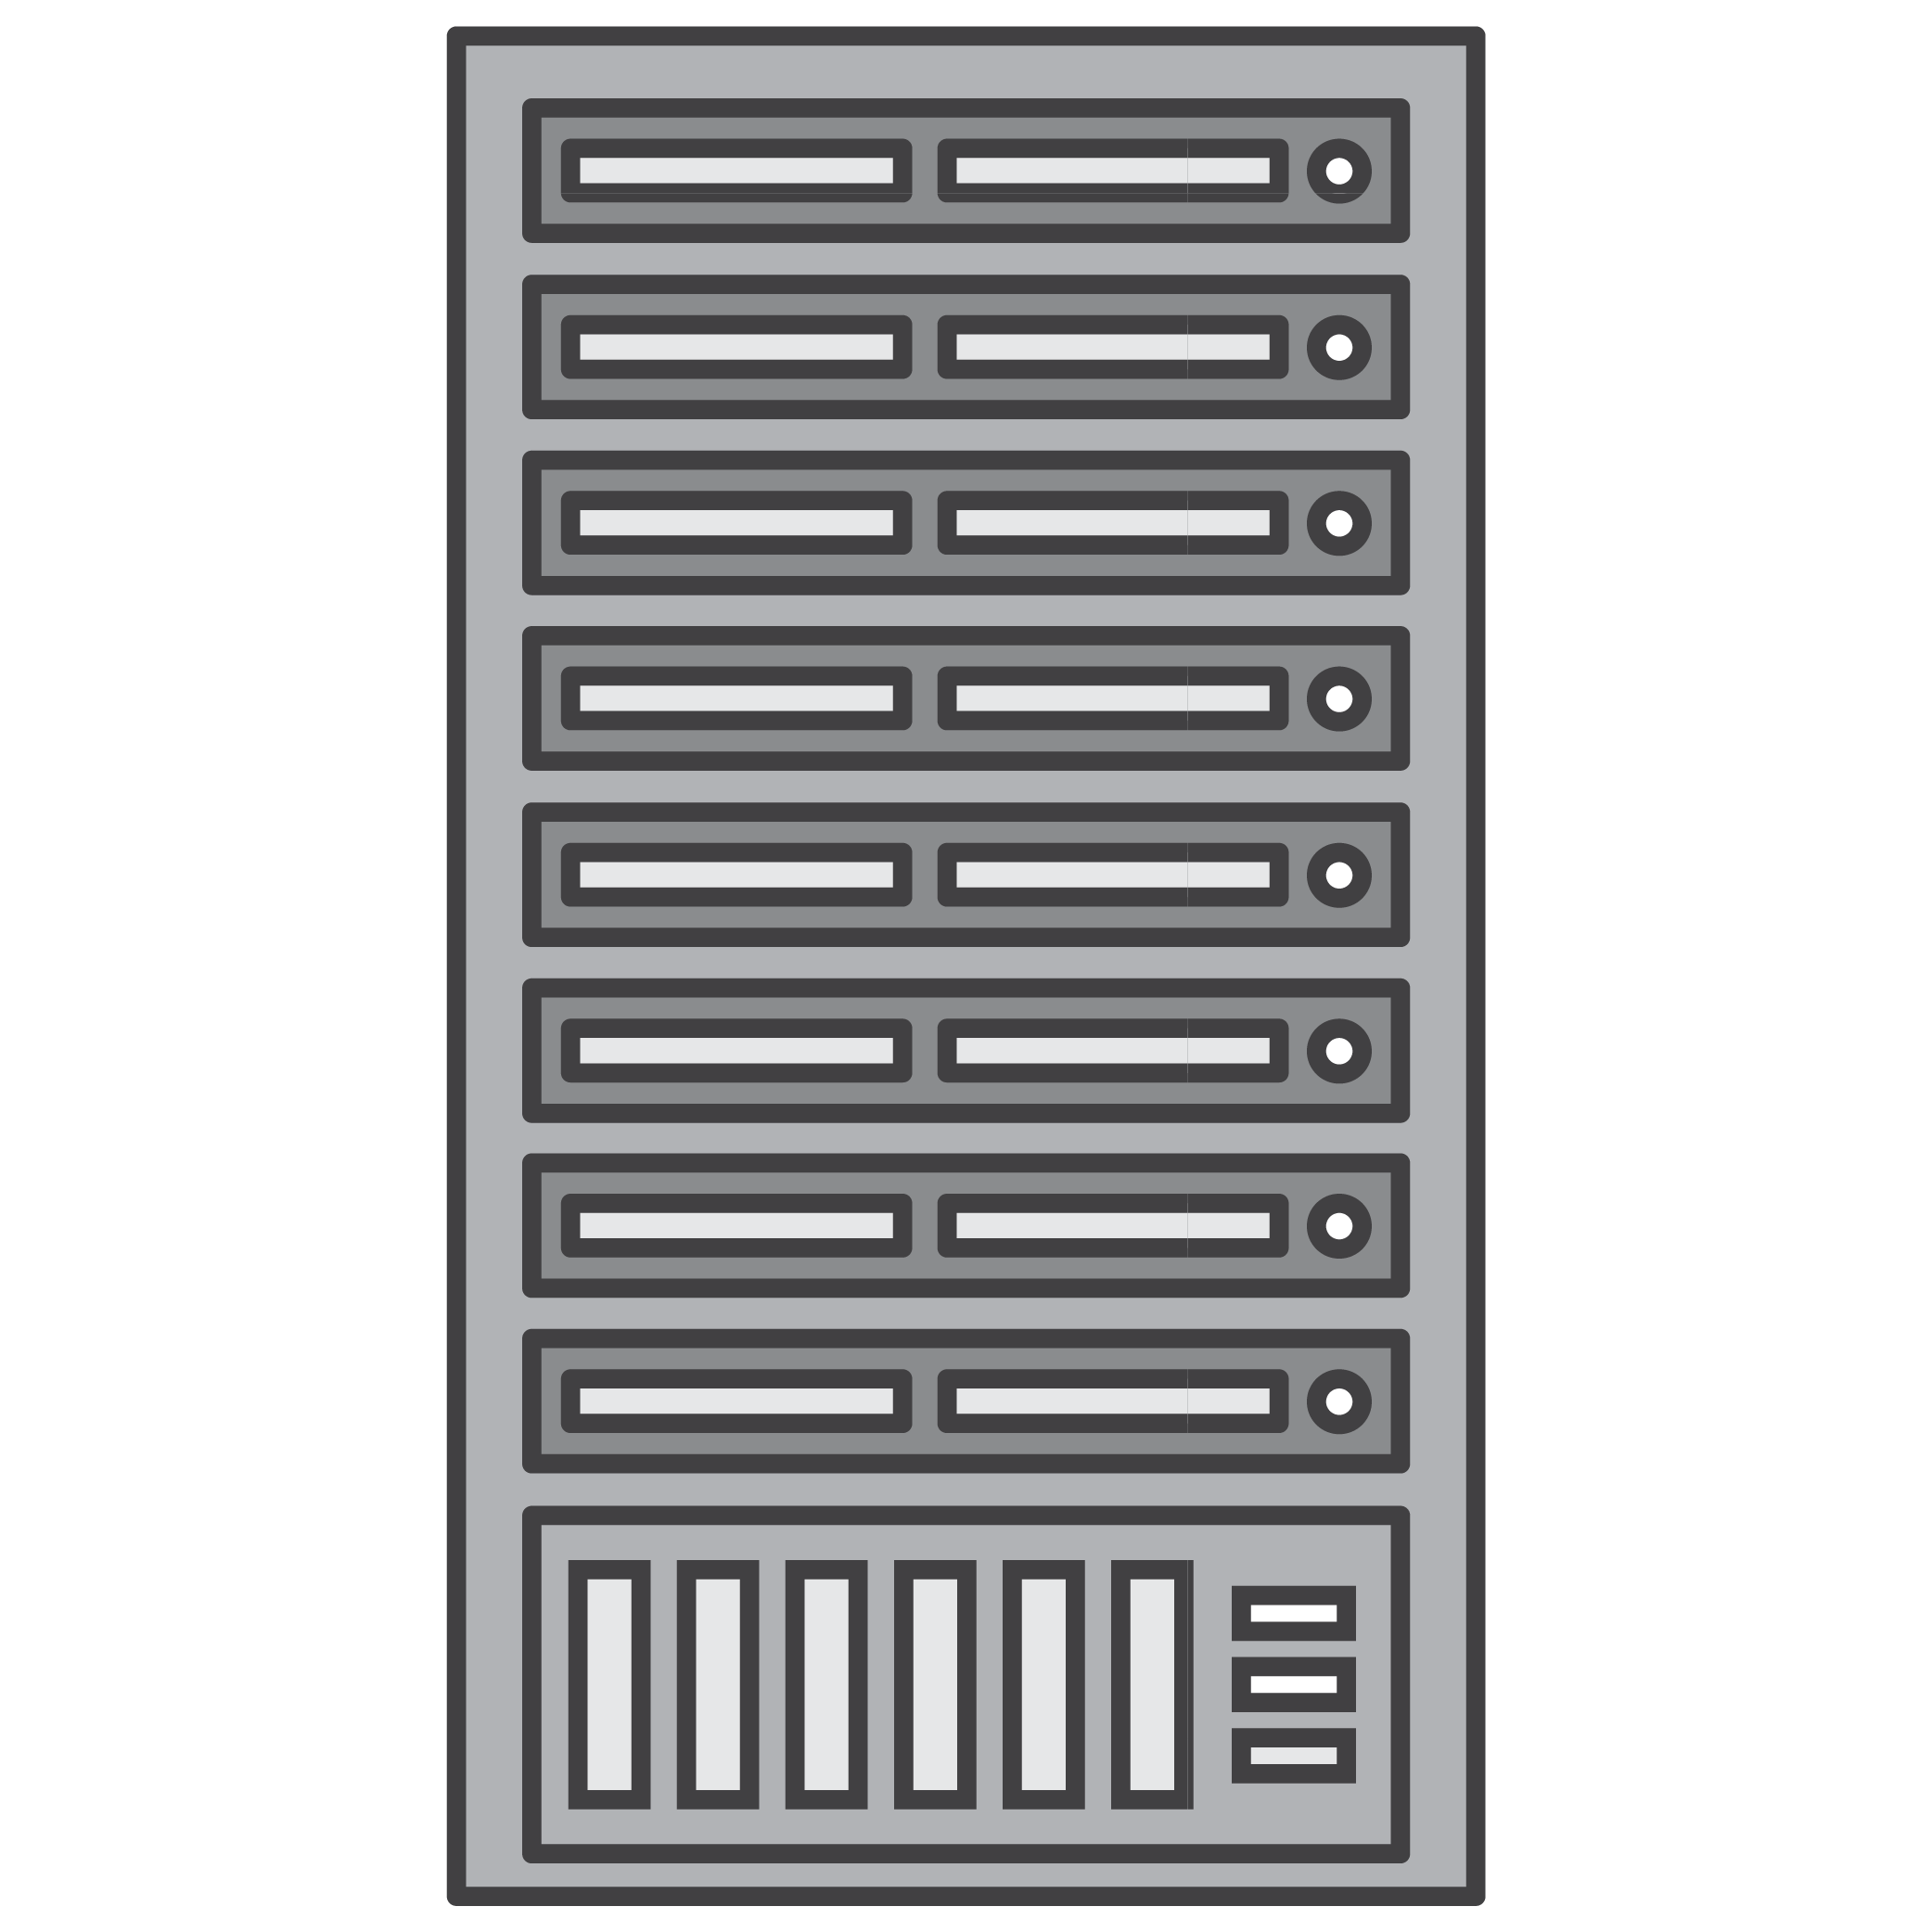

Stop Spending Money on Data Centers
Focus on customers
Focus on projects that differentiate the business
Delegate the racking, stacking and powering of servers to the cloud provider
Notes:
Cloud computing allows you to focus on your customers and your core business - what you are good at - rather than on managing infrastructure. Let someone else manage that for you. Focus on projects that differentiate the business, not the infrastructure. Delegate the racking, stacking and powering of servers to the cloud provider!

Slide 29

Advantage #6: Ease of Deployment
Go global in minutes.
Notes:
Advantage 6: Go global in minutes.
Advantage six is the ability to go global in minutes.
Easily deploy your application in multiple regions around the world with just a few clicks. This means you can provide a lower latency and better experience for your customers simply, and at minimal cost.
Select the link to learn more.
https://www.youtube.com/watch?v=JIQETrFC_SQ.

Slide 30

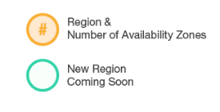
Go Global in Minutes
IRELAND
CANADA
3
BEIJING
OHIO
3
3
FRANKFURT
NINGXIA
OREGON
3
2
LONDON
3
SEOUL
3
3
PARIS
2
2
3
6
2
4
N. CALIFORNIA
1
TOKYO
N. VIRGINIA
OSAKA
AWS GOVCLOUD (US-WEST)
2
MUMBAI
3
SINGAPORE
Region & Number of AZs
3
SÃO PAULO
3
SYDNEY
Notes:
You can be operating locally today and become available globally in minutes by leveraging Amazon CloudFront and our global network of Edge Locations. Deploying in the region where your customers are helps you provide lower latency and a better experience at minimal cost.
To learn more about specific locations, visit the link.
https://aws.amazon.com/about-aws/global-infrastructure/.

Slide 31
Summary
 | Trade capital expense for variable expense.
 | Benefit from massive economies of scale.
 | Eliminate guessing on your capacity needs.
 | Increase speed and agility.
 | Stop spending money to run and maintain data centers.
 | Go global in minutes.
Notes:
The six benefits discussed in this section provide a strong value proposition for moving to the cloud. Each of these benefits should be considered when deciding between an on-premises or cloud solution.
For more information, visit the link. https://d1.awsstatic.com/whitepapers/aws-overview.pdf.

Slide 32
Part 3: What is Amazon Web Services (AWS)?
Notes:
In part three, we’ll learn what Amazon Web Services is.

Slide 33

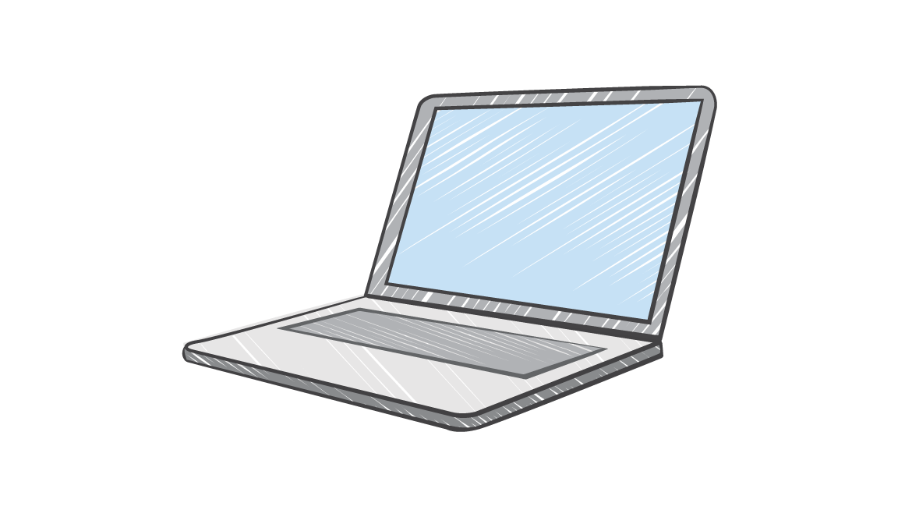

What are Web Services?
A web service is any piece of software that makes itself available over the internet and uses a standardized format (XML or JSON) for the request and the response of an API interaction.
Request message
Internet
Response message
Client
Web service
Notes:
A web service is any piece of software that makes itself available over the Internet or on private (intranet) networks. A web service uses a standardized format (such as XML or JSON) for the request and the response of an API interaction. It is not tied to any one operating system or programming language, it’s self-describing via an interface definition file and is discoverable.

Slide 34
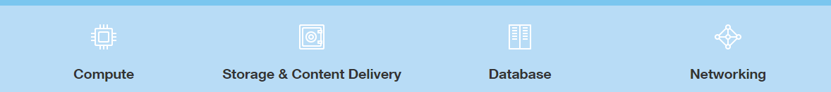
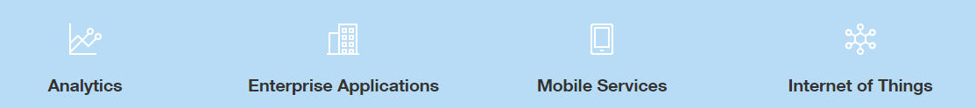
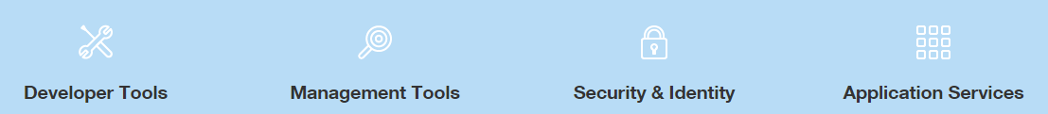
What is AWS?
AWS is a secure cloud platform with more than 165 different services that include solutions for:
AWS Global Infrastructure
Notes:
Amazon Web Services (AWS) is the world’s most comprehensive and broadly adopted cloud platform, offering over 165 fully featured services from data centers globally. It has been architected to be the most flexible and secure cloud computing environment available today.
AWS offers a broad set of global cloud-based products including compute, storage, databases, analytics, networking, mobile, developer tools, management tools, IoT, security, and enterprise applications. These services help organizations move faster, lower IT costs, and scale. AWS is trusted by the largest enterprises and the hottest start-ups to power a wide variety of workloads including: web and mobile applications, game development, data processing and warehousing, storage, archive, and many others.

Slide 35












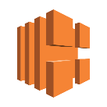












AWS by Category: Core Services
Compute
Networking
Storage
Database
Amazon EC2
AWS Lambda
Amazon VPC
Amazon Route 53
Amazon S3
Amazon EBS
Amazon RDS
Amazon DynamoDB
Auto Scaling
AWS Elastic Beanstalk
Amazon CloudFront
Amazon Glacier
AWS Direct Connect
Elastic Load Balancing
Amazon Redshift
AWS Database Migration Service
Amazon Elastic Container Registry
Amazon Elastic Container Service
Amazon Elastic File System
AWS Snowball
Amazon ElastiCache
Amazon
Lightsail
AWS Batch
Storage
Gateway
AWS Snowmobile
Notes:
AWS offers many services. Core Services refers to a broad and deep group of core cloud infrastructure services. The blue label denotes the service group category. Each of the individual icons represents a service within that group.
AWS services are typically grouped into different categories like compute, networking, storage, applications, databases, and analytics.

Slide 36


















AWS by Category: Foundational Services
Analytics
Enterprise Apps
Mobile Services
Internet of Things
Amazon
EMR
AWS Data
Pipeline
Amazon
WorkSpaces
Amazon
WorkMail
AWS
Mobile Hub
Amazon
SNS
AWS IoT
AWS Greengrass
Amazon
Elasticsearch
Amazon Kinesis
Amazon
Cognito
AWS
Device Farm
Amazon
WorkDocs
Amazon
Machine Learning
Amazon QuickSight
Amazon Mobile Analytics
AWS
Mobile SDKs
Amazon Redshift
Amazon Athena
Amazon
Pinpoint
Notes:
Foundational Services refers to groups of services that offer cloud-based solutions for the analytics, enterprise, mobile, and Internet of Things (IoT) platforms.

Slide 37




























AWS by Category:
Developer and Operations Services
Developer Tools |  | Management Tools |  | Security & Identity |  |  | App Services
AWS CodeCommit | AWS CodeDeploy | Amazon CloudWatch | AWS CloudFormation | AWS Identity and Access Management |  | AWS Directory Service | Amazon API Gateway | Amazon AppStream
AWS CodePipeline | AWS CodeBuild | AWS CloudTrail | AWS Config | Amazon Inspector |  | AWS CloudHSM | Amazon CloudSearch | Amazon Elastic Transcoder
AWS X-Ray |  | AWS OpsWorks | AWS Service Catalog | AWS Key Management Service |  | AWS WAF | Amazon SES | Amazon SNS
 |  | AWS Trusted Advisor |  |  |  |  | Amazon SQS | Amazon SWF
AWS
Organizations
AWS Certificate Manager
AWS
Shield
Notes:
The AWS Developer Tools is a set of services designed to enable developers and IT operations professionals practicing DevOps to rapidly and safely deliver software via Management Tools, security and identify, and app services.

Slide 38
Core Services: The Basics
Compute
Networking
Storage
Database
Amazon EC2
AWS Lambda
Amazon VPC
Amazon Route 53
Amazon S3
Amazon Glacier
Amazon RDS
Amazon DynamoDB
Auto Scaling
AWS Elastic Beanstalk
Amazon CloudFront
Amazon EBS
AWS Direct Connect
Elastic Load Balancing
Amazon Redshift
AWS Database Migration Service
Amazon Elastic Container Registry
Amazon Elastic Container Service
Amazon Elastic File System
AWS Snowball
Amazon ElastiCache
Amazon
Lightsail
AWS Batch
Storage
Gateway
AWS Snowmobile
Notes:
The array of AWS services can be intimidating as you start your journey into the cloud. Initially, you only need to focus on a few ”core” services. You will need to understand the AWS Global Infrastructure, several Compute services, Networking & Content Delivery, Storage, Databases, Security & Identity Access Management, and, finally, Management Tools. Specifically, you should understand the following services from the core service group:
• Compute -- including Amazon Elastic Compute Cloud (or Amazon EC2), AWS Lambda, and AWS Elastic Beanstalk.
• Networking -- including Amazon Virtual Private Cloud (or VPC), Amazon Route 53, and Domain Name Services.
• Storage -- including Amazon S3 (or Simple Storage Service), and Amazon Glacier.
• Databases -- including Amazon RDS (or Relational Database Service), and Amazon DynamoDB (or Non-Relational Database).

Slide 39
Core Services: The Basics
 |  | Management Tools |  | Security & Identity
 |  | Amazon CloudWatch | AWS CloudFormation | AWS Identity and Access Management |  | AWS Directory Service
 |  | AWS CloudTrail | AWS Config | Amazon Inspector |  | AWS CloudHSM
 |  | AWS OpsWorks | AWS Service Catalog | AWS Key Management Service |  | AWS WAF
 |  | AWS Trusted Advisor
AWS
Organizations
AWS Certificate Manager
AWS
Shield
Notes:
From the Developer and Operations group, you should also understand the following:
• Management Tools including CloudWatch and AWS CloudFormation.
• Security and Identity -- including AWS Identity and Access Management (IAM)

Slide 40
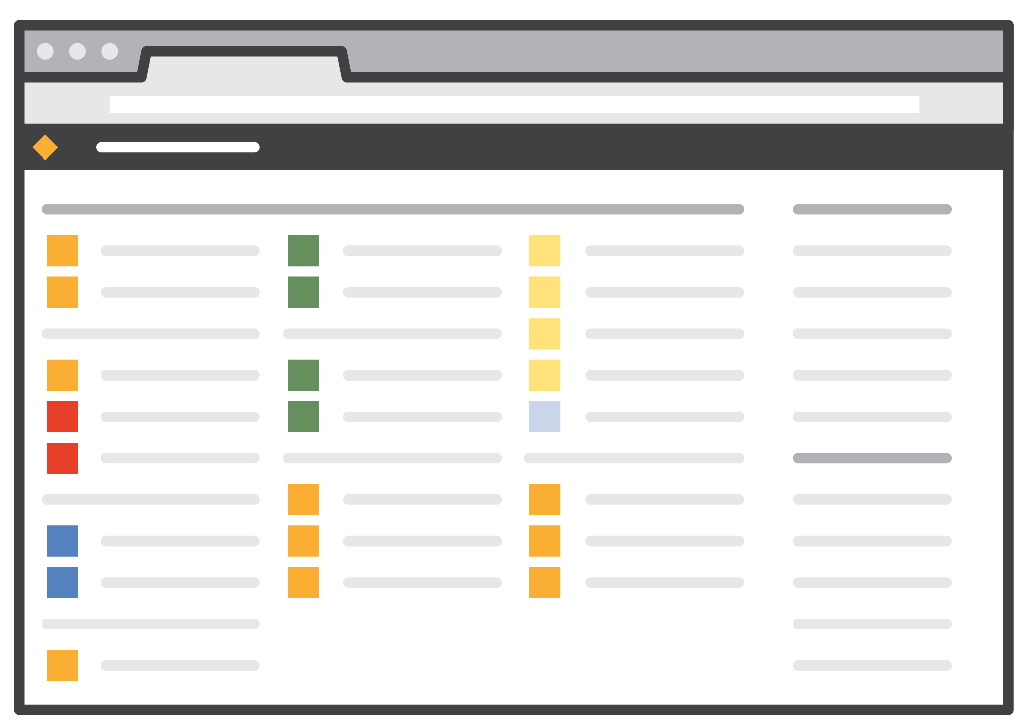
Access to AWS Services
AWS Management Console
Access on the go with AWS Console Mobile App
AWS Command Line Interface (AWS CLI)
Software Development Kits (SDK)
Notes:
You may wonder how to access this broad array of services. You can access them in any of three ways: using the AWS Management Console, the AWS Command Line Interface (AWS CLI), and via Software Development Kits (SDKs). For access on the go, you can use the AWS Console Mobile App to quickly view resources on the go.
The AWS Management console breaks down AWS services into separate categories, like Compute, Management Tools, Mobile Services, etc. Each category has a number of different services in it, and all of the services can be accessed from the console. For example, the Compute category contains Amazon EC2, Amazon EC2 Container Service, Amazon Lightsail, AWS Elastic Beanstalk, AWS Lambda, and AWS Batch.
The AWS CLI is a unified tool to manage your AWS services. With just one tool to download and configure, you can control multiple AWS services from the CLI and automate them through scripts. The CLI User Guide instructs you on how to install and configure the tool. After that, you can begin making calls to your AWS services from the CLI.
Simplify using AWS services in your applications with an Application Programming Interface (or API) tailored to your programming language or platform.
To learn more, visit the links.
https://aws.amazon.com/console/mobile/
https://docs.aws.amazon.com/cli/latest/userguide/cli-chap-welcome.html
https://aws.amazon.com/tools/ https://docs.aws.amazon.com/apigateway/latest/developerguide/welcome.html

Slide 41
Part 4: The AWS Cloud Adoption Framework
Notes:
In part four, we’ll discuss the AWS Cloud Adoption Framework, which helps organizations understand how cloud adoption transforms the way they work, and it provides structure to identify and address gaps in skills and processes.

Slide 42
AWS Cloud Adoption Framework (CAF)
Perspectives in planning, creating, managing, and supporting a modern IT service
Guidelines for establishing, developing, and running AWS environments
Structure for business and IT teams to work together
Business
Operations
People
AWS
CAF
Security
Governance
Platform
Notes:
AWS Professional Services created the AWS Cloud Adoption Framework (AWS CAF) to help organizations develop efficient and effective plans for their cloud adoption journey. The guidance and best practices provided by the framework help you build a comprehensive approach to cloud computing across your organization, and throughout your IT lifecycle.
The AWS CAF breaks down the complex process of planning a move to the cloud into manageable pieces called perspectives. Perspectives represent essential areas of focus that span people, processes, and technology. Capabilities within each perspective identify which areas of your organization require attention. From that, actions are organized into prescriptive work streams that support a successful cloud journey.
The AWS Cloud Adoption Framework provides guidelines for establishing, developing, and running AWS environments. You’ll receive guidance that supports each unit in your organization so that each area understands how to update skills, adapt existing processes, and introduce new processes to take maximum advantage of the services provided by cloud computing.
This provides a structure for business and IT teams to work together. Thousands of organizations around the world have successfully migrated their businesses to the cloud, relying on the AWS Cloud Adoption Framework to guide their efforts. AWS and our partners provide tools and services that can help you every step of the way to ensure complete understanding and transition.

Slide 43
Six Core Perspectives
Business Perspective
How will your architectural approaches align technical delivery to business imperatives?
Platform Perspective
What patterns, guidance, and tools are necessary to optimize your use of technology services on AWS?
People Perspective
What skills are needed in order to adopt the AWS cloud platform? Examples include guiding processes of role descriptions, training, certification, and mentoring.
Security Perspective
How will you define and implement the required levels of security, governance, and risk management to achieve compliance?
Governance Perspective
How to update the staff skills and organizational processes necessary to ensure business governance in the cloud, and manage and measure cloud investments to evaluate business outcomes?
Operations Perspective
How will you provide process, guidance, and tools for optimum operational service management of the AWS environment?
Notes:
At the highest level, the AWS Cloud Adoption Framework (AWS CAF) organizes guidance into six areas of focus, called perspectives.
Each perspective covers distinct responsibilities owned or managed by functionally related stakeholders. In general, the Business, People, and Governance Perspectives focus on business capabilities; while the Platform, Security, and Operations Perspectives focus on technical capabilities.
For more information about the AWS CAF visit the link http://bit.ly/AWSCAF.

Slide 44


Summary
Defined cloud computing and alternative implementation models
Described the advantages of cloud computing
Explored AWS services
Discussed the AWS CAF
To finish this module:
Complete:
Knowledge Assessment
Notes:
In summary, we defined cloud computing and alternative implementation models. We described the advantages of cloud computing, explored AWS services, and discussed the AWS Cloud Adoption Framework.
To finish this module, complete the knowledge assessment.

Slide 45
Up Next: Section 1.0.2 – Cloud Economics Review Pricing Fundamentals Understand Total Cost of Ownership
Notes:
Up next, we will move on to Section 1.0.2 where we review the basics of cloud economics.
We’ll review pricing fundamentals and understand the total cost of ownership.

Slide 46
Thanks for participating!
© 2018 Amazon Web Services, Inc. or its affiliates. All rights reserved. This work may not be reproduced or redistributed, in whole or in part, without prior written permission from Amazon Web Services, Inc. Commercial copying, lending, or selling is prohibited. Corrections or feedback on the course, please email us at: aws-course-feedback@amazon.com. For all other questions, contact us at: https://aws.amazon.com/contact-us/aws-training/. All trademarks are the property of their owners.
Notes:
Thanks for participating!

